Slide 1
Variables and Surfing
OCE2901 – Surf Engineering Analysis
OCE5903 – Ocean Engineering Data Analysis

Slide 2

Introduction What are we doing?
Check out this YouTube video: https://youtu.be/vUt8fWLqXGg?t=1178
19:38 – 23:10

Slide 3
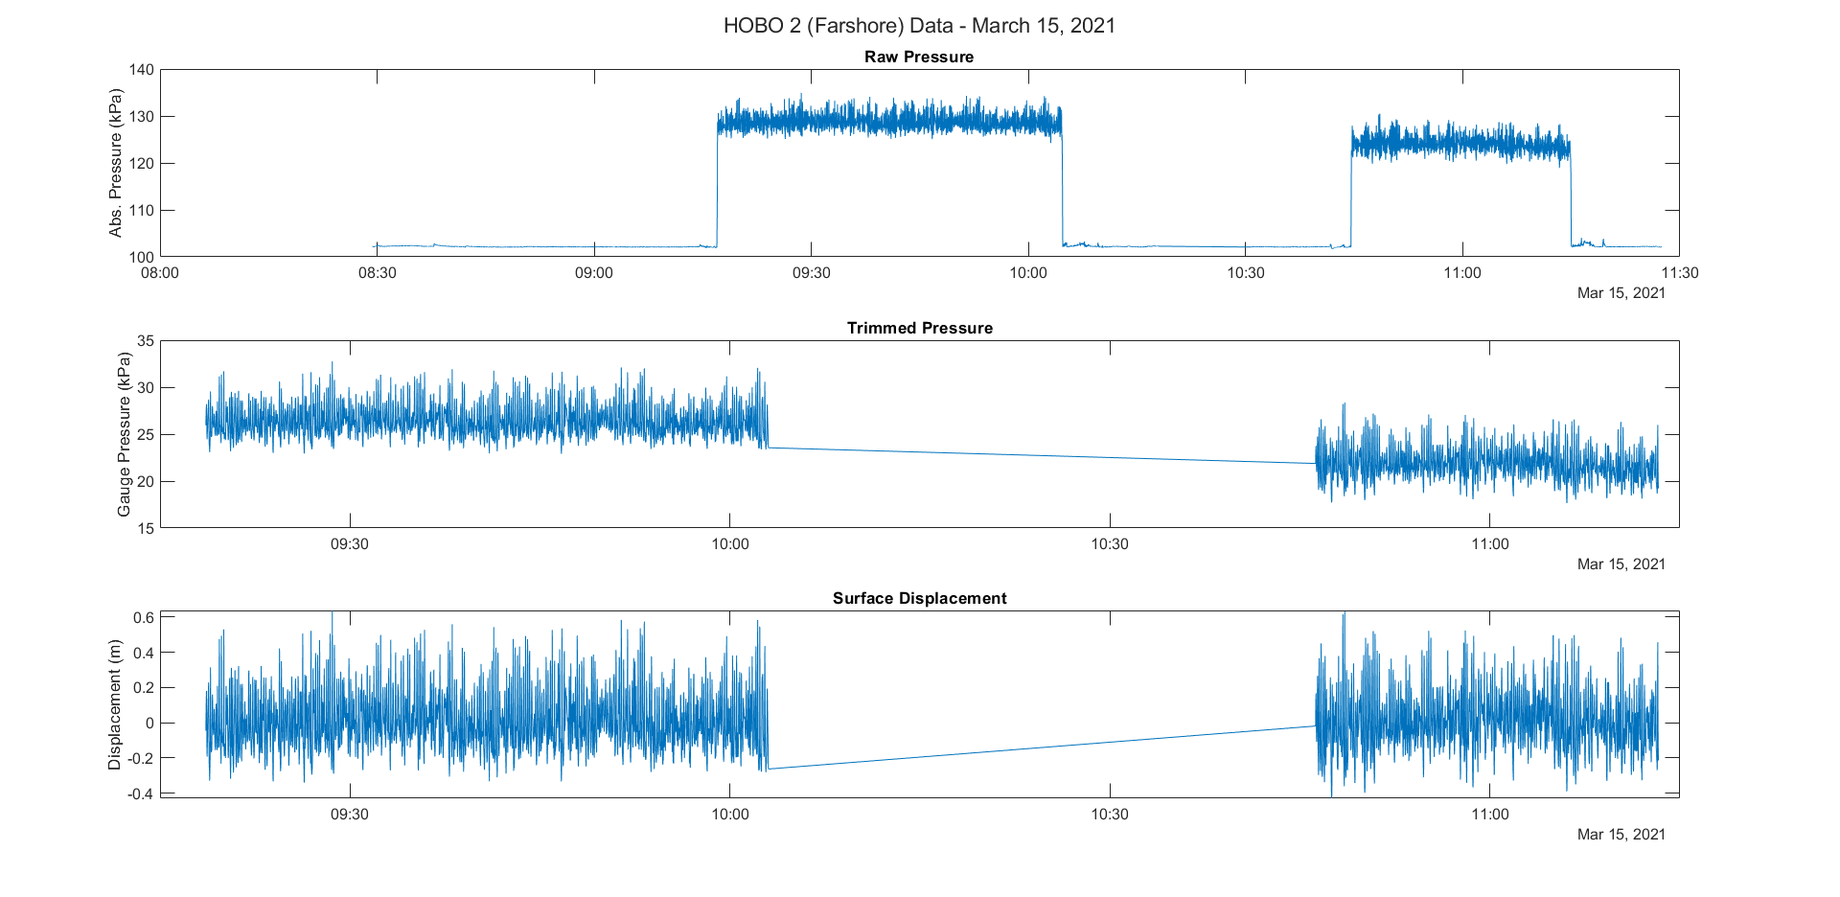
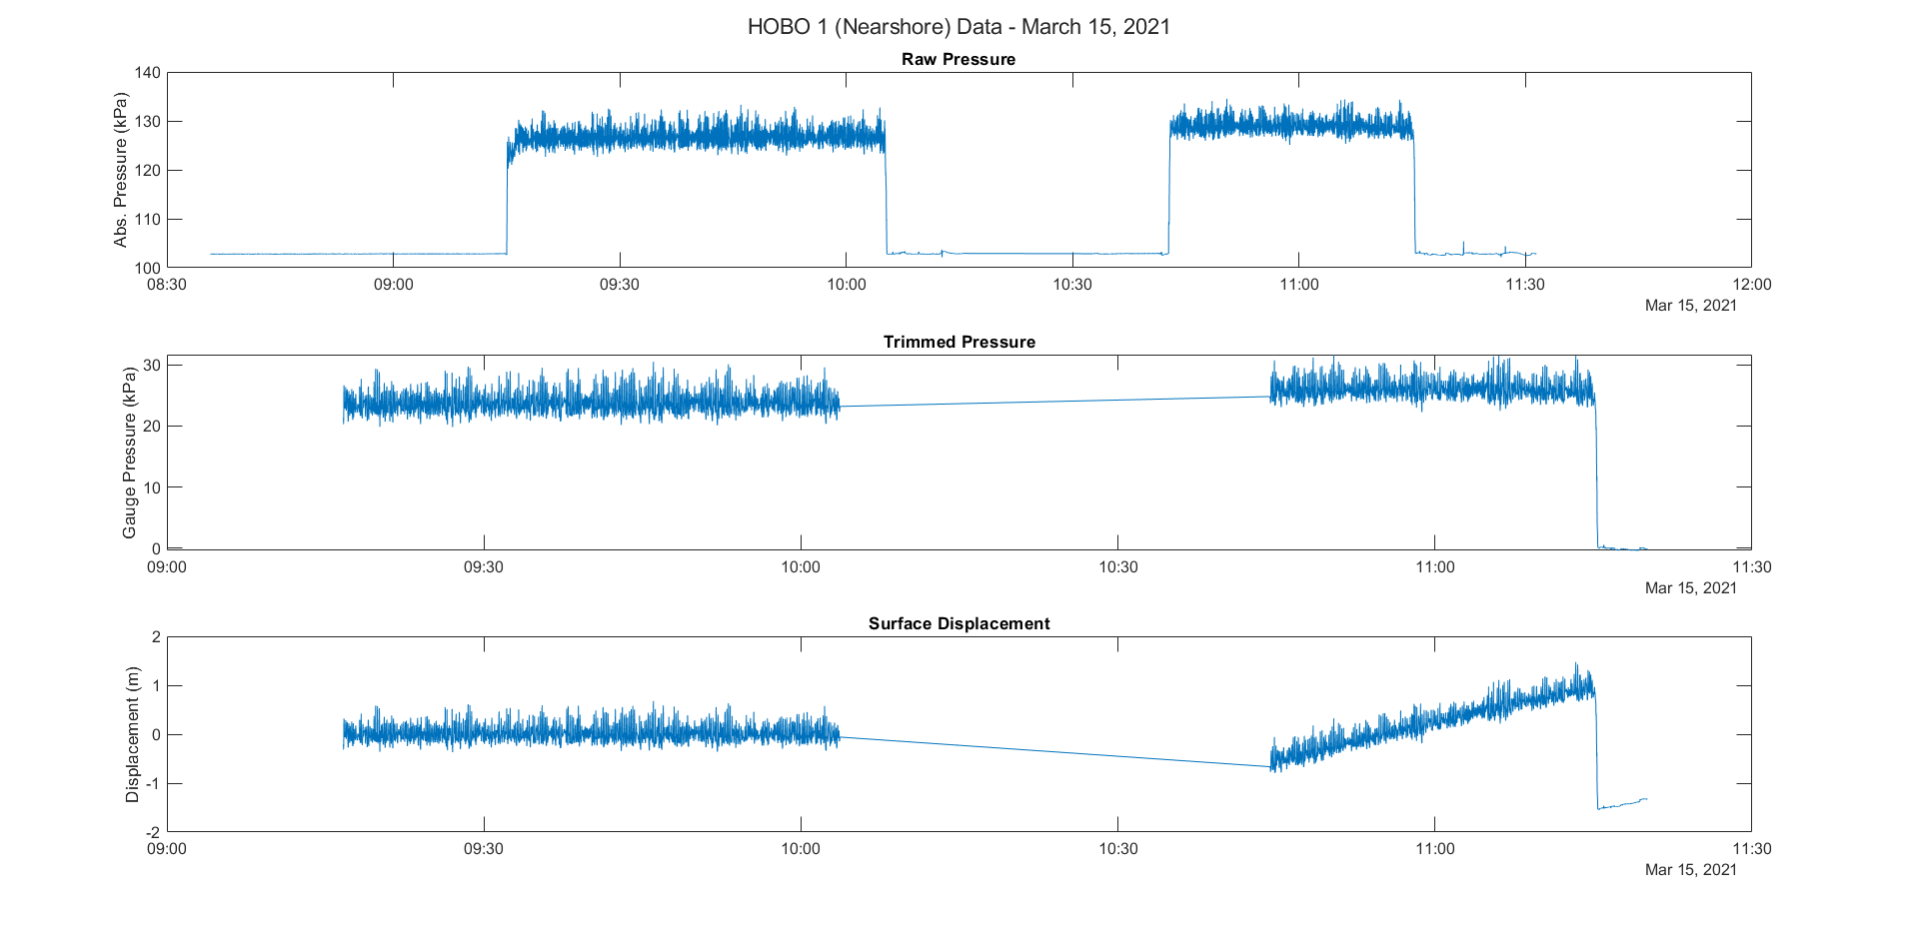
What is Data Analysis?
Process of processing and looking at data to discern relationships present in the data
For this course, we will be looking at how surfers interact with coastal waves

